Slide 1
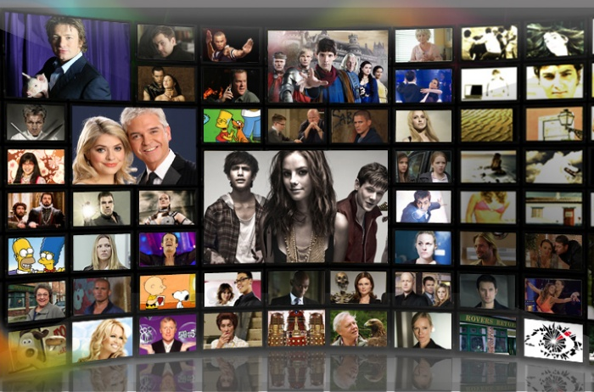


Previous Teleplays
Popularity Tendency Clustering
Social Media
Web Search

